Slide 1
SWAPPING

Slide 2
Swapping in Operating System
To increase CPU utilization in multiprogramming, a memory management scheme known as swapping can be used.
Swapping is the process of bringing a process into memory and then temporarily copying it to the disc after it has run for a while.
The purpose of swapping in an operating system is to access data on a hard disc and move it to RAM so that application programs can use it.
It’s important to remember that swapping is only used when data isn’t available in RAM.
Although the swapping process degrades system performance, it allows larger and multiple processes to run concurrently.
Because of this, swapping is also known as memory compaction.

Slide 3
Swapping in Operating System
The CPU scheduler determines which processes are swapped in and which are swapped out
Consider a multiprogramming environment that employs a priority-based scheduling algorithm.
When a high-priority process enters the input queue, a low-priority process is swapped out so the high-priority process can be loaded and executed.
When this process terminates, the low priority process is swapped back into memory to continue its execution.

Slide 4
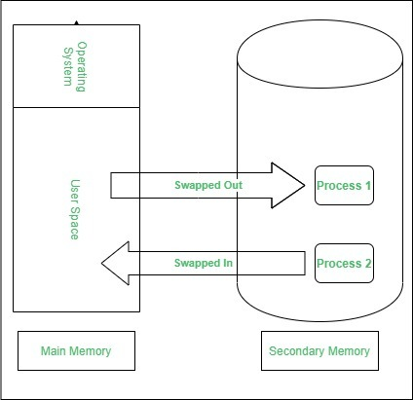
Swapping in Operating System: Below figure shows the swapping process in operating system:
Swapping has been subdivided into two concepts: swap-in and swap-out.
Swap-out is a technique for moving a process from RAM to the hard disc.
Swap-in is a method of transferring a program from a hard disc to main memory, or RAM.

Slide 5
Swapping in Operating System Advantages:
If there is low main memory so some processes may has to wait for much long but by using swapping process do not have to wait long for execution on CPU.
It utilize the main memory.
Using only single main memory, multiple process can be run by CPU using swap partition.
The concept of virtual memory start from here and it utilize it in better way.
This concept can be useful in priority based scheduling to optimize the swapping process.

Slide 6
Swapping in Operating System Disadvantages:
If there is low main memory resource and user is executing too many processes and suddenly the power of system goes off there might be a scenario where data get erase of the processes which are took parts in swapping.
Chances of number of page faults occur
Low processing performance

Slide 7
Contiguous Memory Allocation

Slide 8
Contiguous Memory Allocation
Contiguous Memory Allocation is a type of memory allocation technique where processes are allotted a continuous block of space in memory.
This block can be of fixed size for all the processes in a fixed-size partition scheme or can be of variable size depending on the requirements of the process in a variable-size partition scheme.

Slide 9
What is Contiguous Memory Allocation in OS?
Contiguous memory allocation in the operating system is a memory allocation technique. But what is memory allocation? When a program or process is to be executed, it needs some space in the memory. For this reason, some part of the memory has to be allotted to a process according to its requirements. This process is called memory allocation.
One such memory allocation technique is contiguous memory allocation. As the name implies, we allocate contiguous blocks of memory to each process using this technique. So, whenever a process wants to enter the main memory, we allocate a continuous segment from the totally empty space to the process based on its size.

Slide 10
Contiguous Memory Allocation Techniques:
Whenever a process has to be allocated space in the memory, following the contiguous memory allocation technique, we have to allot the process a continuous empty block of space to reside. This allocation can be done in two ways:
Fixed-size Partition Scheme
Variable-size Partition Scheme

Slide 11
Contiguous Memory Allocation Techniques: Fixed-size Partition Scheme
In this type of contiguous memory allocation technique, each process is allotted a fixed-size continuous block in the main memory.
That means there will be continuous blocks of fixed size into which the complete memory will be divided, and each time a process comes in, it will be allotted one of the free blocks.
Because irrespective of the size of the process, each is allotted a block of the same size memory space. This technique is also called static partitioning.

Slide 12
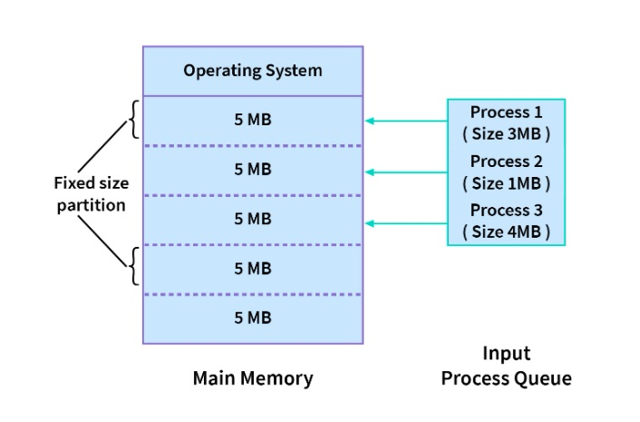
Contiguous Memory Allocation Techniques: Fixed-size Partition Scheme

Slide 13
Contiguous Memory Allocation Techniques: Fixed-size Partition Scheme
In the diagram above, we have 3 processes in the input queue that have to be allotted space in the memory. As we are following the fixed-size partition technique, the memory has fixed-sized blocks.
The first process, which is of size 3MB is also allotted a 5MB block, and the second process, which is of size 1MB, is also allotted a 5MB block, and the 4MB process is also allotted a 5MB block. So, the process size doesn't matter. Each is allotted the same fixed-size memory block.
It is clear that in this scheme, the number of continuous blocks into which the memory will be divided will be decided by the amount of space each block covers, and this, in turn, will dictate how many processes can stay in the main memory at once.
Note: The number of processes that can stay in the memory at once is called the degree of multiprogramming. Hence, the degree of multiprogramming of the system is decided by the number of blocks created in the memory.

Slide 14
Contiguous Memory Allocation Techniques: Fixed-size Partition Scheme
Advantages
Because all of the blocks are the same size, this scheme is simple to implement. All we have to do now is divide the memory into fixed blocks and assign processes to them.
It is easy to keep track of how many blocks of memory are left, which in turn decides how many more processes can be given space in the memory.
As at a time multiple processes can be kept in the memory, this scheme can be implemented in a system that needs multiprogramming.

Slide 15
Contiguous Memory Allocation Techniques: Fixed-size Partition Scheme
Disadvantages
Though the fixed-size partition scheme has many advantages, it also has some disadvantages:
As the size of the blocks is fixed, we will not be able to allot space to a process that has a greater size than the block.
The size of the blocks decides the degree of multiprogramming, and only that many processes can remain in the memory at once as the number of blocks.
If the size of the block is greater than the size of the process, we have no other choice but to assign the process to this block, but this will lead to much empty space left behind in the block. This empty space could've been used to accommodate a different process. This is called internal fragmentation. Hence, this technique may lead to space wastage.

Slide 16
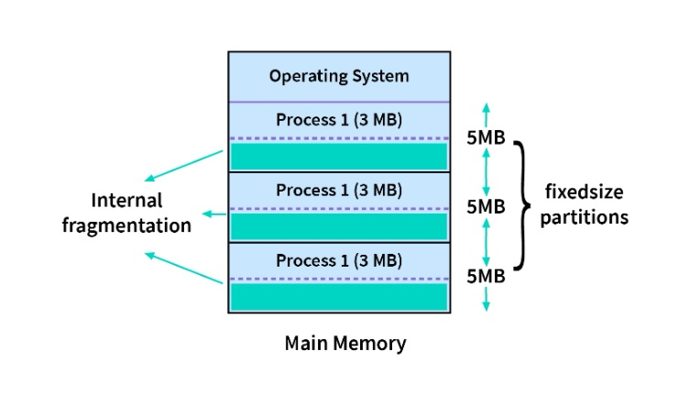
Contiguous Memory Allocation Techniques: Fixed-size Partition Scheme
Internal fragmentation

Slide 17
Contiguous Memory Allocation Techniques: Variable-size Partition Scheme
In this type of contiguous memory allocation technique, no fixed blocks or partitions are made in the memory.
Instead, each process is allotted a variable-sized block depending upon its requirements. That means, that whenever a new process wants some space in the memory, if available, this amount of space is allotted to it.
Hence, the size of each block depends on the size and requirements of the process which occupies it.

Slide 18
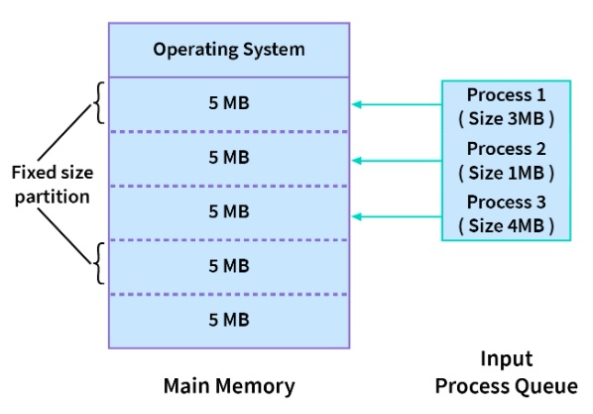
Contiguous Memory Allocation Techniques: Variable-size Partition Scheme
In the diagram,
There are no fixed-size partitions.
Instead, the first process needs 3MB memory space and hence is allotted that much only.
Similarly, the other 3 processes are allotted only that much space that is required by them.

Slide 19
Contiguous Memory Allocation Techniques: Variable-size Partition Scheme Advantages
As the processes have blocks of space allotted to them as per their requirements, there is no internal fragmentation. Hence, there is no memory wastage in this scheme.
The number of processes that can be in the memory at once will depend upon how many processes are in the memory and how much space they occupy. Hence, it will be different for different cases and will be dynamic.
As there are no blocks that are of fixed size, even a process of big size can be allotted space.

Slide 20
Contiguous Memory Allocation Techniques: Variable-size Partition Scheme Disadvantages
Though the variable-size partition scheme has many advantages, it also has some disadvantages:
Because this approach is dynamic, a variable-size partition scheme is difficult to implement.
It is difficult to keep track of processes and the remaining space in the memory.

Slide 21
Strategies Used for Contiguous Memory Allocation Input Queues
So far, we've seen the two types of schemes for contiguous memory allocation. But what happens when a new process comes in and has to be allotted a space in the main memory? How is it decided which block or segment it will get?
Processes that have been assigned continuous blocks of memory will fill the main memory at any given time. However, when a process completes, it leaves behind an empty block known as a hole. This space could also be used for a new process. Hence, the main memory consists of processes and holes, and any one of these holes can be allotted to a new incoming process. We have three strategies to allot a hole to an incoming process:

Slide 22
Strategies Used for Contiguous Memory Allocation Input Queues
Strategies Used for Contiguous Memory Allocation Input Queues.
First-Fit Memory Allocation
Best-Fit Memory Allocation
Worst-Fit Memory Allocation

Slide 23
Strategies Used for Contiguous Memory Allocation Input Queues
First-Fit Memory Allocation
This is a very basic strategy in which we start from the beginning and allot the first hole, which is big enough as per the requirements of the process.
The first-fit strategy can also be implemented in a way where we can start our search for the first-fit hole from the place we left off last time.

Slide 24
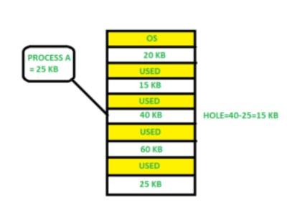
Strategies Used for Contiguous Memory Allocation Input Queues: First-Fit Memory Allocation

Slide 25
Strategies Used for Contiguous Memory Allocation Input Queues
Best-Fit Memory Allocation:
This is a greedy strategy that aims to reduce any memory wasted because of internal fragmentation in the case of static partitioning, and hence we allot that hole to the process, which is the smallest hole that fits the requirements of the process.
Hence, we need to first sort the holes according to their sizes and pick the best fit for the process without wasting memory.

Slide 26
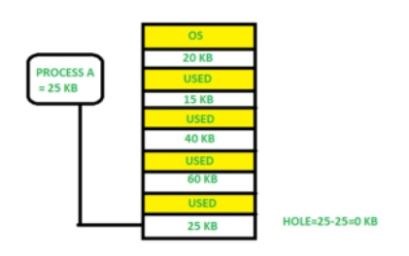
Strategies Used for Contiguous Memory Allocation Input Queues: Best-Fit Memory Allocation:

Slide 27
Strategies Used for Contiguous Memory Allocation Input Queues
Worst-Fit Memory Allocation:
This strategy is the opposite of the Best-Fit strategy. We sort the holes according to their sizes and choose the largest hole to be allotted to the incoming process.
The idea behind this allocation is that as the process is allotted a large hole, it will have a lot of space left behind as internal fragmentation.
Hence, this will create a hole that will be large enough to accommodate a few other processes.

Slide 28
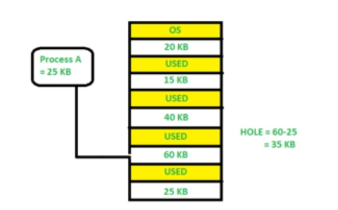
Strategies Used for Contiguous Memory Allocation Input Queues Worst-Fit Memory Allocation:

Slide 29
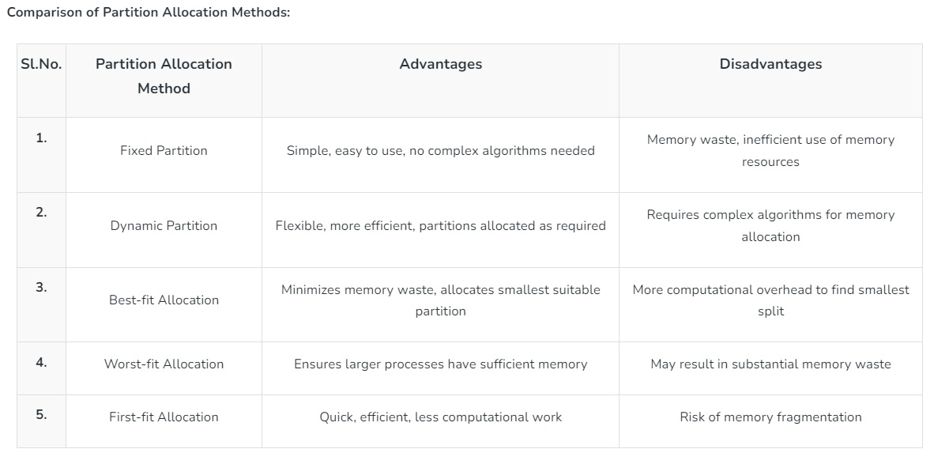

Slide 30
Conclusion
In contiguous memory allocation, we allocate contiguous blocks of memory to each process when it is brought in the main memory to be executed.
There are two techniques for contiguous memory allocation:
Fixed Size Partitioning: Each process is allotted to a fixed size continuous block in the main memory.
Variable Size Partitioning: Each process is allotted space depending upon its requirements. There is no defined fixed-size block.
There are three strategies to allot a hole to an incoming process:
First-Fit: Allot the process to the first hole, which is big enough.
Best-Fit: Allot the smallest hole that satisfies the requirements of the process.
Worst-Fit: Allot the largest size hole among all to the incoming process.

Slide 31
Paging

Slide 32
Paging in Operating System
Paging is a memory management scheme that eliminates the need for contiguous allocation of physical memory.
The process of retrieving processes in the form of pages from the secondary storage into the main memory is known as paging.
The basic purpose of paging is to separate each procedure into pages. Additionally, frames will be used to split the main memory.
This scheme permits the physical address space of a process to be non – contiguous.

Slide 33
Paging in Operating System
Let us look some important terminologies:
Logical Address or Virtual Address (represented in bits): An address generated by the CPU
Logical Address Space or Virtual Address Space( represented in words or bytes): The set of all logical addresses generated by a program
Physical Address (represented in bits): An address actually available on memory unit
Physical Address Space (represented in words or bytes): The set of all physical addresses corresponding to the logical addresses.

Slide 34
Paging in Operating System
Example:
If Logical Address = 31 bit, then Logical Address Space = 2³¹ words = 2 G words (1 G = 2³⁰)
If Logical Address Space = 128 M words = 2⁷ * 2²⁰ words, then Logical Address = log₂ 2²⁷ = 27 bits
If Physical Address = 22 bit, then Physical Address Space = 2²² words = 4 M words (1 M = 2²⁰)
If Physical Address Space = 16 M words = 2⁴ * 2²⁰ words, then Physical Address = log₂ 2²⁴ = 24 bits

Slide 35
Paging in Operating System
The mapping from virtual to physical address is done by the memory management unit (MMU) which is a hardware device and this mapping is known as paging technique.
The Physical Address Space is conceptually divided into a number of fixed-size blocks, called frames.
The Logical address Space is also splitted into fixed-size blocks, called pages.
Page Size = Frame Size
Let us consider an example:
Physical Address = 12 bits, then Physical Address Space = 4 K words
Logical Address = 13 bits, then Logical Address Space = 8 K words
Page size = frame size = 1 K words (assumption)

Slide 36
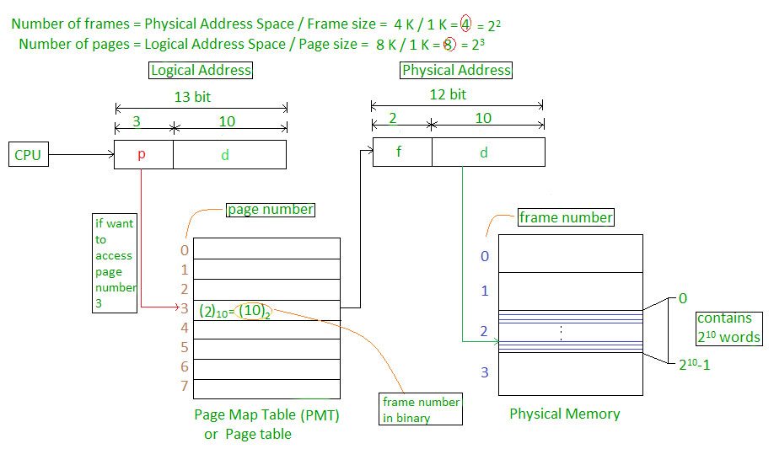

Slide 37
Paging in Operating System
Address generated by CPU is divided into
Page number(p): Number of bits required to represent the pages in Logical Address Space or Page number
Page offset(d): Number of bits required to represent particular word in a page or page size of Logical Address Space or word number of a page or page offset.
Physical Address is divided into
Frame number(f): Number of bits required to represent the frame of Physical Address Space or Frame number.
Frame offset(d): Number of bits required to represent particular word in a frame or frame size of Physical Address Space or word number of a frame or frame offset.

Slide 38
Paging in Operating System
The hardware implementation of page table can be done by using dedicated registers. But the usage of register for the page table is satisfactory only if page table is small. If page table contain large number of entries then we can use TLB(translation Look-aside buffer), a special, small, fast look up hardware cache.
The TLB is associative, high speed memory.
Each entry in TLB consists of two parts: a tag and a value.
When this memory is used, then an item is compared with all tags simultaneously. If the item is found, then corresponding value is returned.

Slide 39
Thank you

Slide 40
Segmentation

Slide 41
Segmentation in Operating System
A process is divided into Segments. The chunks that a program is divided into which are not necessarily all of the same sizes are called segments. Segmentation gives the user’s view of the process which paging does not give. Here the user’s view is mapped to physical memory. There are types of segmentation:
Virtual memory segmentation – Each process is divided into a number of segments, not all of which are resident at any one point in time.
Simple segmentation – Each process is divided into a number of segments, all of which are loaded into memory at run time, though not necessarily contiguously.

Slide 42
Segmentation in Operating System
There is no simple relationship between logical addresses and physical addresses in segmentation. A table stores the information about all such segments and is called Segment Table. Segment Table – It maps two-dimensional Logical address into one-dimensional Physical address. It’s each table entry has:
Base Address: It contains the starting physical address where the segments reside in memory.
Limit: It specifies the length of the segment.

Slide 43
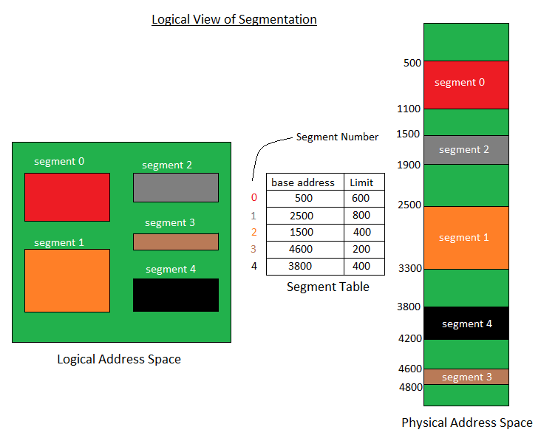

Slide 44
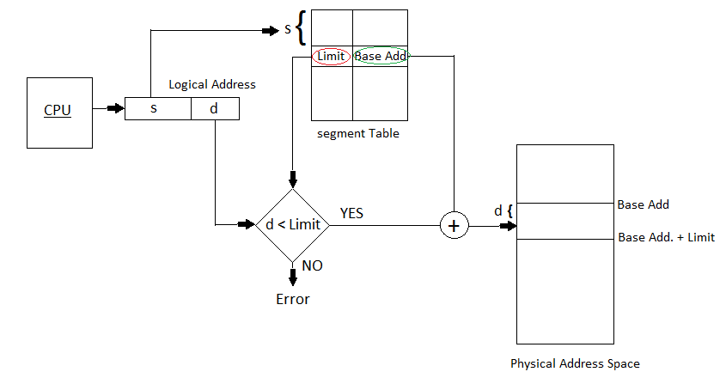
Translation of Two dimensional Logical Address to dimensional Physical Address.

Slide 45
Translation of Two dimensional Logical Address to dimensional Physical Address.
Segment number (s): Number of bits required to represent the segment.
Segment offset (d): Number of bits required to represent the size of the segment.

Slide 46
Advantages of Segmentation –
No Internal fragmentation.
Segment Table consumes less space in comparison to Page table in paging.
As a complete module is loaded all at once, segmentation improves CPU utilization.
The user’s perception of physical memory is quite similar to segmentation. Users can divide user programmes into modules via segmentation. These modules are nothing more than the separate processes’ codes.
The user specifies the segment size, whereas in paging, the hardware determines the page size.
Segmentation is a method that can be used to segregate data from security operations.

Slide 47
Disadvantage of Segmentation –
As processes are loaded and removed from the memory, the free memory space is broken into little pieces, causing External fragmentation.
Overhead is associated with keeping a segment table for each activity.
Due to the need for two memory accesses, one for the segment table and the other for main memory, access time to retrieve the instruction increases.

Slide 48
Introduction to Linux

Slide 49
Linux Operating System
The Linux Operating System is a type of operating system that is similar to Unix, and it is built upon the Linux Kernel.
The Linux Kernel is like the brain of the operating system because it manages how the computer interacts with its hardware and resources.
It makes sure everything works smoothly and efficiently. But the Linux Kernel alone is not enough to make a complete operating system.

Slide 50
Linux Operating System
To create a full and functional system, the Linux Kernel is combined with a collection of software packages and utilities, which are together called Linux distributions.
These distributions make the Linux Operating System ready for users to run their applications and perform tasks on their computers securely and effectively.
Linux distributions come in different flavors, each tailored to suit the specific needs and preferences of users.

Slide 51
What is Linux
Linux is a powerful and flexible family of operating systems that are free to use and share.
It was created by a person named Linus Torvalds in 1991.
What’s cool is that anyone can see how the system works because its source code is open for everyone to explore and modify.
This openness encourages people from all over the world to work together and make Linux better and better.

Slide 52
What is Linux
Since its beginning, Linux has grown into a stable and safe system used in many different things, like computers, smartphones, and big supercomputers.
It’s known for being efficient, meaning it can do a lot of tasks quickly, and it’s also cost-effective, which means it doesn’t cost a lot to use.
Lots of people love Linux, and they’re part of a big community where they share ideas and help each other out.
As technology keeps moving forward, Linux will keep evolving and staying important in the world of computers.

Slide 53
Linux Distribution
Around 600 + Linux Distributions are available and some of the popular Linux distributions are:
MX Linux
Manjaro
Linux Mint
elementary
Ubuntu
Debian
Solus
Fedora
openSUSE
Deepin
Linux distribution is an operating system that is made up of a collection of software based on Linux kernel or you can say distribution contains the Linux kernel and supporting libraries and software.
And you can get Linux based operating system by downloading one of the Linux distributions and these distributions are available for different types of devices like embedded devices, personal computers, etc.

Slide 54
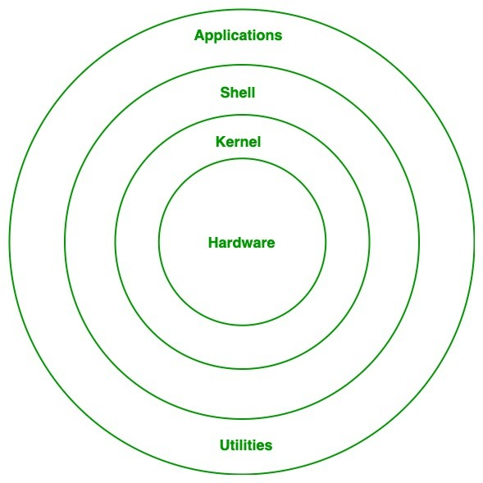
Architecture of Linux
Linux architecture has the following components:

Slide 55
Architecture of Linux
1. Kernel: Kernel is the core of the Linux based operating system. It virtualizes the common hardware resources of the computer to provide each process with its virtual resources. This makes the process seem as if it is the sole process running on the machine. The kernel is also responsible for preventing and mitigating conflicts between different processes. Different types of the kernel are:
Monolithic Kernel- an operating system architecture where the entire operating system is working in kernel space
Hybrid kernels- an operating system kernel architecture that attempts to combine aspects and benefits of microkernel and monolithic kernel architectures used in operating systems.
Exo kernels- Exokernel is an operating system kernel developed by the MIT Parallel and Distributed Operating Systems group, and also a class of similar operating systems. Operating systems generally present hardware resources to applications through high-level abstractions such as file systems
Micro kernels- A microkernel is a type of operating system kernel that is designed to provide only the most basic services required for an operating system to function

Slide 56
Architecture of Linux
2. System Library: Linux uses system libraries, also known as shared libraries, to implement various functionalities of the operating system. These libraries contain pre-written code that applications can use to perform specific tasks. By using these libraries, developers can save time and effort, as they don’t need to write the same code repeatedly. System libraries act as an interface between applications and the kernel, providing a standardized and efficient way for applications to interact with the underlying system.

Slide 57
Architecture of Linux
3. Shell:The shell is the user interface of the Linux Operating System. It allows users to interact with the system by entering commands, which the shell interprets and executes. The shell serves as a bridge between the user and the kernel, forwarding the user’s requests to the kernel for processing. It provides a convenient way for users to perform various tasks, such as running programs, managing files, and configuring the system.

Slide 58
Architecture of Linux
4. Hardware Layer: The hardware layer encompasses all the physical components of the computer, such as RAM (Random Access Memory), HDD (Hard Disk Drive), CPU (Central Processing Unit), and input/output devices. This layer is responsible for interacting with the Linux Operating System and providing the necessary resources for the system and applications to function properly. The Linux kernel and system libraries enable communication and control over these hardware components, ensuring that they work harmoniously together.

Slide 59
Architecture of Linux
5. System Utility: System utilities are essential tools and programs provided by the Linux Operating System to manage and configure various aspects of the system. These utilities perform tasks such as installing software, configuring network settings, monitoring system performance, managing users and permissions, and much more. System utilities simplify system administration tasks, making it easier for users to maintain their Linux systems efficiently.

Slide 60
Advantages of Linux
1. The main advantage of Linux is it is an open-source operating system. This means the source code is easily available for everyone and you are allowed to contribute, modify and distribute the code to anyone without any permissions.
2.In terms of security, Linux is more secure than any other operating system. It does not mean that Linux is 100 percent secure, it has some malware for it but is less vulnerable than any other operating system. So, it does not require any anti-virus software.
3. The software updates in Linux are easy and frequent.
4. Various Linux distributions are 6. It has large community support. available so that you can use them according to your requirements or according to your taste.
5. Linux is freely available to use on the internet.

Slide 61
Advantages of Linux
6. It has large community support.
7. It provides high stability. It rarely slows down or freezes and there is no need to reboot it after a short time.
8. It maintains the privacy of the user.
9. The performance of the Linux system is much higher than other operating systems. It allows a large number of people to work at the same time and it handles them efficiently.
10. It is network friendly.

Slide 62
Disadvantages of Linux
It is not very user-friendly. So, it may be confusing for beginners.
It has small peripheral hardware drivers as compared to windows.

Slide 63
Features of Linux
The following are various features of Linux operating system:
1. Low Cost
2. Stability
3. Performance
4. Networking
5. Flexibility
6. Compatibility
7. Fast and Easy Installation
8. Better use of Hard Disk
9. Multitasking
10. Open Source
11. Powerful Kernel

Slide 64
Features of Linux
1. Low Cost
There is no need to spend time and huge amount money to obtain licenses since Linux and much of its software come with the GNU General Public License. There is no need to worry about any software that you use in Linux.
2. Stability
Linux has high stability compared with other operating systems. There is no need to reboot the Linux system to maintain performance levels rarely. Its freezes up or slow down. It has a continuous up-times of hundreds of days or more.

Slide 65
Features of Linux
3. Performance
Linux provides high performance on various networks. It has the ability to handle large numbers of users simultaneously.
4. Networking
Linux provides a strong support for network functionality; client and server systems can be easily set up on any computer running Linux. It can perform tasks like network backup faster than other operating systems.

Slide 66
Features of Linux
5. Flexibility
Linux is very flexible. Linux can be used for high performance server applications, desktop applications, and embedded systems. You can install only the needed components for a particular use. You can also restrict the use of specific computers.
6. Compatibility
It runs all common Unix software packages and can process all common file formats.

Slide 67
Features of Linux
7. Fast and Easy Installation
Linux distributions come with user-friendly installation.
8. Better use of Hard Disk
Linux uses its resources well enough even when the hard disk is almost full.
9. Multitasking
Linux is a multitasking operating system. It can handle many things at the same time.
10. Open Source
Linux is an Open source operating systems. You can easily get the source code for Linux and edit it to develop your personal operating system.

Slide 68
Features of Linux
11. Powerful Kernel
The kernel is heart of the Linux operating system. It manages the resources of Linux. Resources include:
File management
Multitasking
Memory management
I/O management
Process management
Device management
Introduction to Linux
Networking support including IPv4 and IPv6

Slide 69
Introduction to vi editor.
The vi editor is one of most popular text editors on Linux. It is a command-line-based editor that comes pre-installed on most Linux distributions. Although it may seem daunting to new users, it is a powerful and efficient tool for editing text files. In this guide, we will cover basics of using vi editor on Linux..

Slide 70
introduction to vi editor.
Opening vi Editor
To open vi editor, open a terminal window and type "vi" followed by name of file you want to edit. For example, to edit a file called "example.txt", type −
If file does not exist, vi will create a new file with that name. Once you have opened a file in vi, you will see contents of file on screen.
vi example.txt

Slide 71
introduction to vi editor.
Modes in vi
One of most important concepts to understand when using vi is concept of modes.
vi has two modes:
command mode
insert mode.

Slide 72
Command Mode: When you first open a file in vi, you are in command mode. In command mode, you can use various keyboard commands to navigate file and perform various editing functions. Here are some of most commonly used commands in command mode −
Command Mode
Command Mode
h − Move cursor left
j − Move cursor down
k − Move cursor up
l − Move cursor right
i − Switch to insert mode
x − Delete character under cursor
dd − Delete current line
:w − Save file
:q − Quit vi
:q! − Quit vi without saving changes

Slide 73
introduction to vi editor.
Insert Mode
Insert mode is used to enter text into file. To switch to insert mode from command mode, press "i" key. In insert mode, you can enter text just like you would in any other text editor. To return to command mode, press "Esc" key.
Editing Text
To edit text in vi, you must first be in command mode. Then, use various commands available in command mode to make changes to text. For example, to delete a line of text, position cursor on line you want to delete and type "dd". To delete a single character, position cursor on character and type "x“.

Slide 74
introduction to vi editor.
Moving Cursor
One of most important functions of vi is navigating text using keyboard. Here are some of most commonly used commands for moving cursor −
h − Move cursor left
j − Move cursor down
k − Move cursor up
l − Move cursor right
0 − Move cursor to beginning of line
$ − Move cursor to end of line
G − Move cursor to end of file
gg − Move cursor to beginning of file

Slide 75
introduction to vi editor.
Searching for Text
To search for text in vi, you must be in command mode. Then, type "/searchterm" and press Enter. vi will search for first instance of "searchterm" in file and position cursor on it. To search for next instance of search term, type "n". To search for previous instance, type "N".
Replacing Text
To replace text in vi, you must be in command mode. Position cursor on character you want to replace and type "r" followed by replacement character. To replace a word, position cursor on first character of word and type "cw" followed by replacement text.
Saving and Quitting
To save changes to a file in vi, you must be in command mode. Type ":w" and press Enter. To quit vi, type ":q". If you have made changes to file and want to save them before quitting, type ":wq" and press Enter. If you want to quit without saving changes, type ":q!" and press Enter.

Slide 76
introduction to vi editor.
User information commands:
id command – Shows effective UID
logname command – View user name that you used to log in
whoami command – Shows user name of currently effective UID
groups command – Lists all groups you are a member of

Slide 77
Command | Function
ls | Lists a directiory's content
pwd | Shows the current working directory’s path
cd | Changes the working directory
mkdir | Creates a new directory
rm | Deletes a file
cp | Copies files and directories, including their content
mv | Moves or renames files and directories
touch | Creates a new empty file
file | Checks a file’s type
zip and unzip | Creates and extracts a ZIP archive
tar | Archives files without compression in a TAR format
nano, vi | Edits a file with a text editor
cat | Lists, combines, and writes a file’s content as a standard output
grep | Searches a string within a file

Slide 78
Thank you

